Slide 1
Laplace Transform

Slide 2

Definition of Laplace Transform
The Laplace Transform is an integral transformation of a function f(t) from the time domain into the complex frequency domain, giving F(s)
s: complex frequency
Called “The One-sided or unilateral Laplace Transform”.
In the two-sided or bilateral LT, the lower limit is -∞. We do not use this.

Slide 3
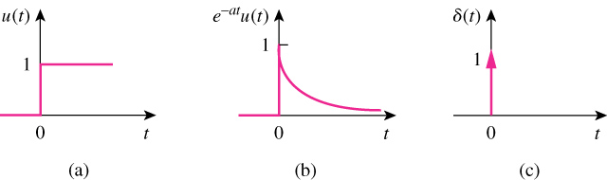
Definition of Laplace Transform
Example 1
Determine the Laplace transform of each of the following functions shown below:

Slide 4
Definition of Laplace Transform
Solution:
The Laplace Transform of unit step, u(t) is given by

Slide 5
Definition of Laplace Transform
Solution:
The Laplace Transform of exponential function, e^{-αt}u(t),α>0 is given by

Slide 6
Definition of Laplace Transform
Solution:
The Laplace Transform of impulse function,
δ(t) is given by

Slide 7
Functional Transform

Slide 8
TYPE | f(t) | F(s)
Impulse
Step
Ramp
Exponential
Sine
Cosine

Slide 9
TYPE | f(t) | F(s)
Damped ramp
Damped sine
Damped cosine

Slide 10
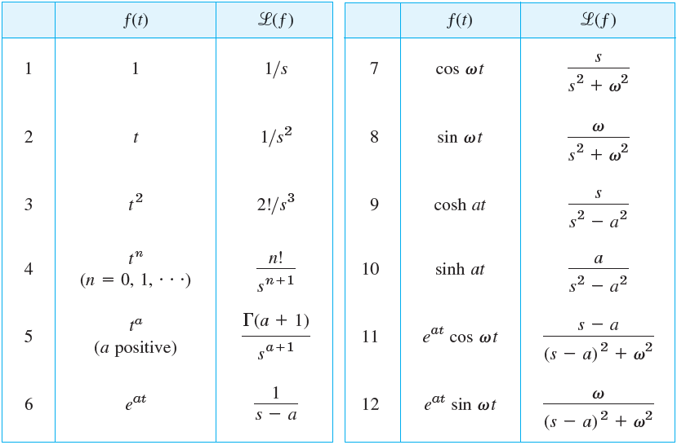

Slide 11
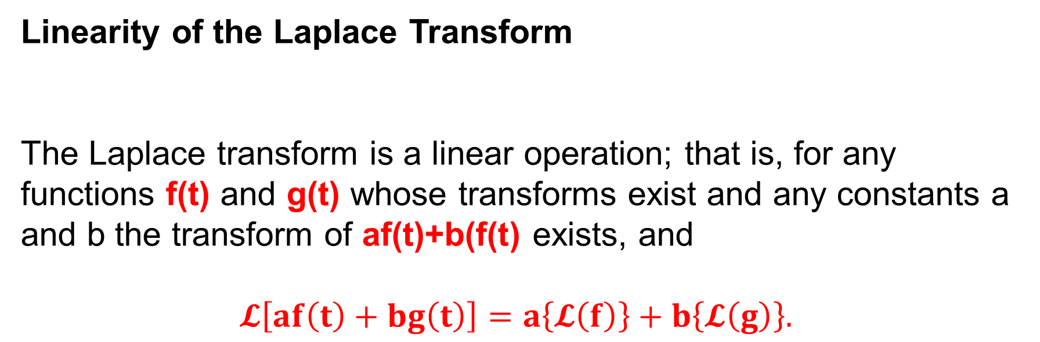

Slide 12
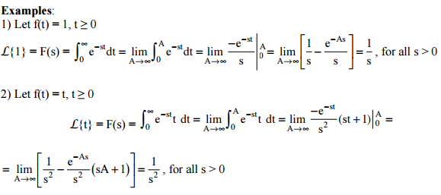

Slide 13
Time shifting property (t-a)
The time-shifting property of the Laplace transform states that if we have a function f(t) that is multiplied by the unit step function u(t-a), then its Laplace transform is given by e^(-as) times the Laplace transform of f(t-a). In other words, the Laplace transform of f(t-a)u(t-a) is e^(-as) times the Laplace transform of f(t-a).

Slide 14
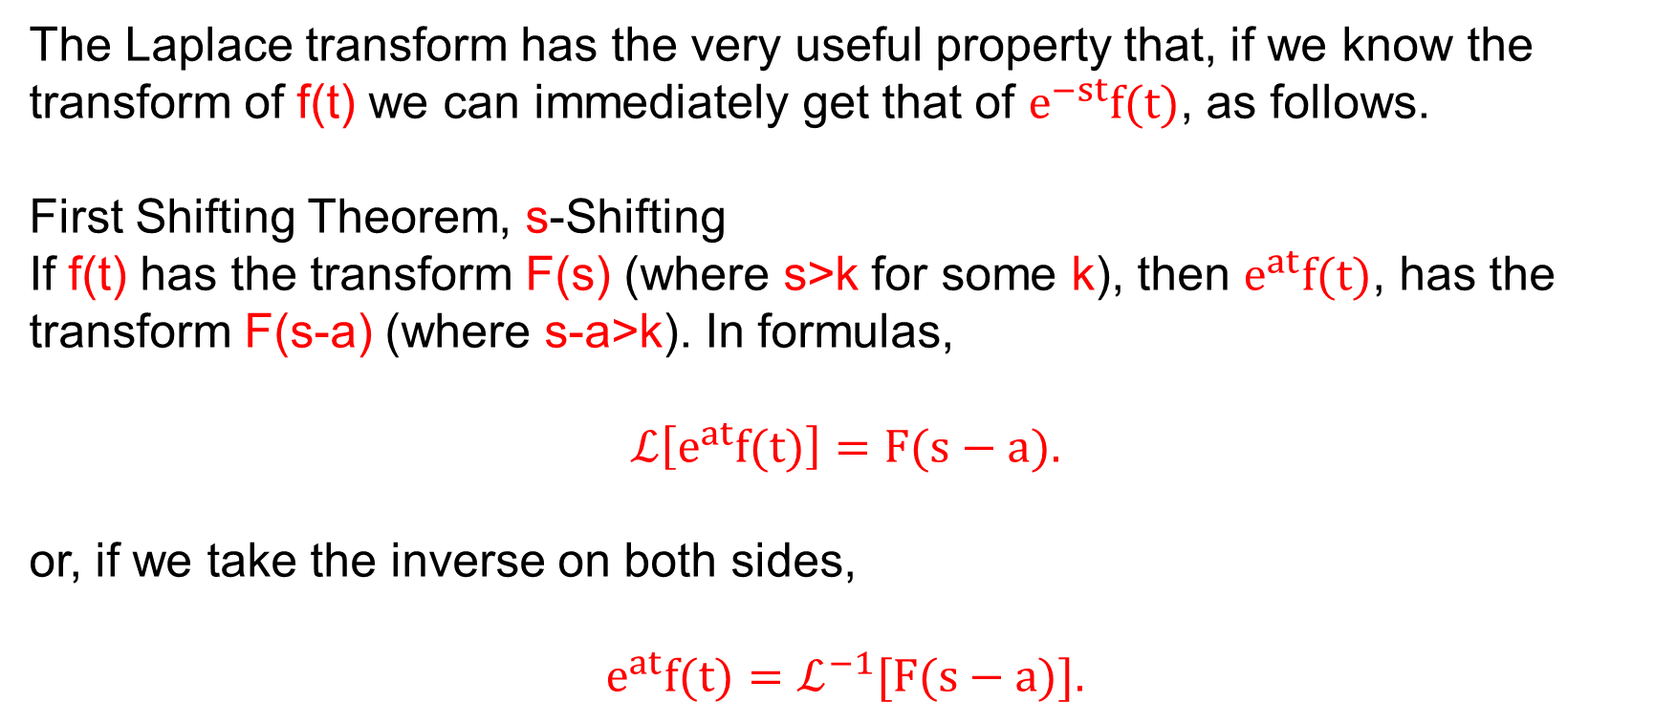
space-Shifting: Replacing s by s-a

Slide 15
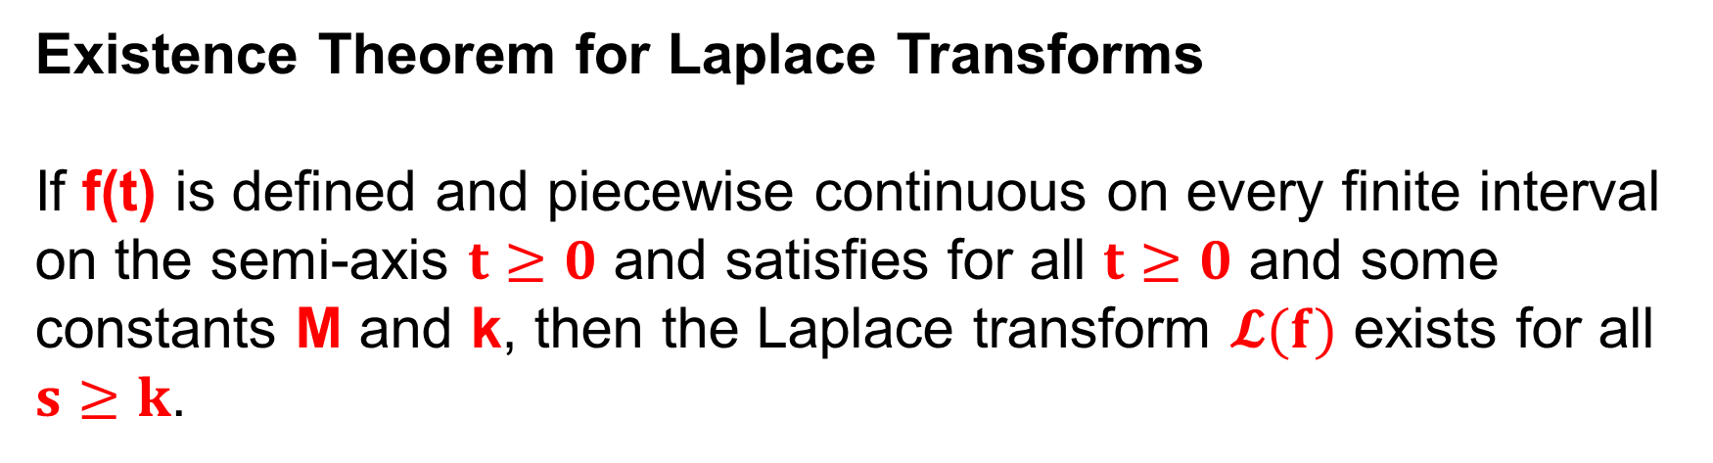

Slide 16
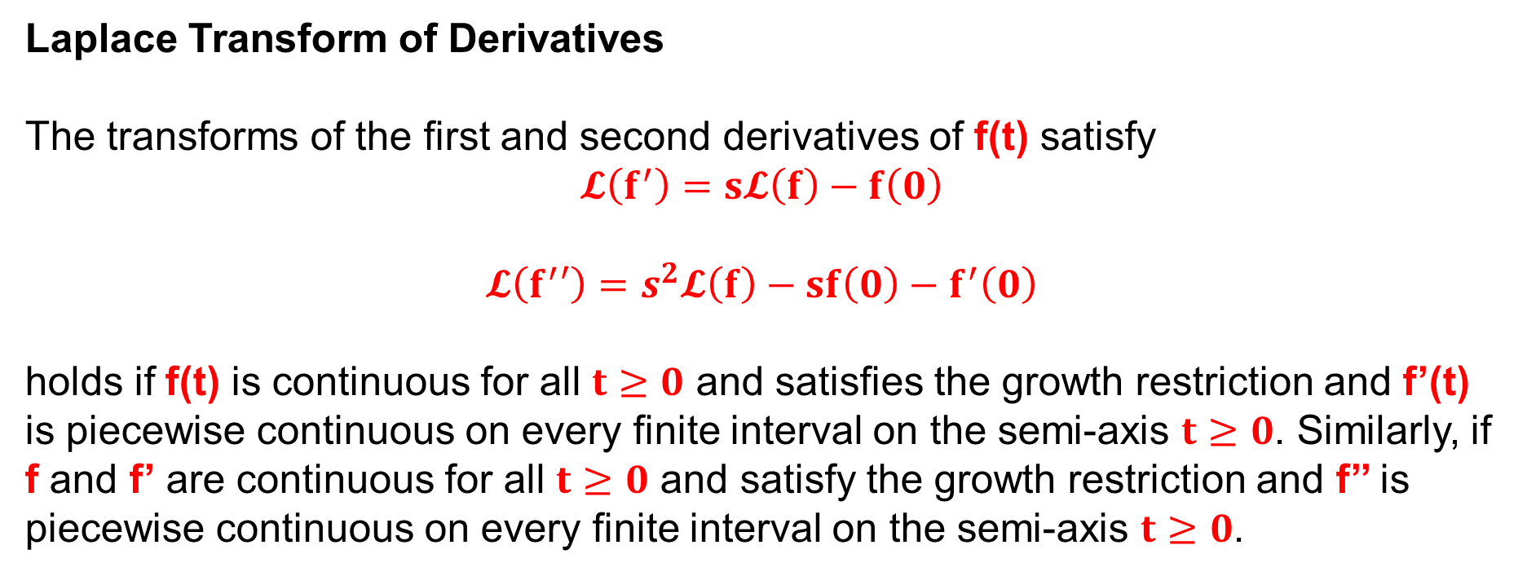

Slide 17
Derivative in time-domain:
Derivative in frequency-domain:

Slide 18

Integration:
Convolution:

Slide 19
Initial Value Theorem:
The initial value theorem of Laplace transform states that the limit of a function as time approaches zero is equal to the limit of its Laplace transform as the Laplace variable approaches infinity. In other words, the initial conditions of a system can be obtained from its Laplace transform.

Slide 20
Final Value Theorem:
The final value theorem of Laplace transform states that the limit of a function as time approaches infinity is equal to the limit of its Laplace transform as the Laplace variable approaches zero. In other words, the steady-state behavior of a system can be obtained from its Laplace transform.

Slide 21

The integration property of the Laplace transform states that the Laplace transform of the integral of a function f(t) from 0 to t is given by the product of the Laplace transform of f(t) and 1/s:

Slide 22
Properties of Laplace Transform
Step Function
The symbol for the step function is K u(t).
Mathematical definition of the step function:

Slide 23
f(t) = K u(t)

Slide 24
Properties of Laplace Transform
Step Function
A discontinuity of the step function may occur at some time other than t=0.
A step that occurs at t=a is expressed as:

Slide 25
f(t) = K u(t-a)

Slide 26
Expression of step functions
Linear function +2t: on at t=0, off at t=1
Linear function -2t+4: on at t=1, off at t=3
Linear function +2t-8: on at t=3, off at t=4
Step function can be used to turn on and
turn off these functions

Slide 27
Step Functions

Slide 28
Properties of Laplace Transform
Impulse Function
The symbol for the impulse function is δ(t).
Mathematical definition of the impulse function:

Slide 29
Properties of Laplace Transform
Impulse Function
The area under the impulse function is constant and represents the strength of the impulse.
The impulse is zero everywhere except at t=0.
An impulse that occurs at t = a is denoted K δ(t-a)

Slide 30
f(t) = K δ(t)

Slide 31
Properties of Laplace Transform
Linearity
If F₁(s) and F₂(s) are, respectively, the Laplace Transforms of f₁(t) and f₂(t)

Slide 32
Properties of Laplace Transform
Scaling
If F (s) is the Laplace Transforms of f (t), then

Slide 33
Properties of Laplace Transform
Time Shift
If F (s) is the Laplace Transforms of f (t), then

Slide 34
The Inverse Laplace Transform
Suppose F(s) has the general form of
The finding the inverse Laplace transform of F(s) involves two steps:
Decompose F(s) into simple terms using partial fraction expansion.
Find the inverse of each term by matching entries in Laplace Transform Table.

Slide 35
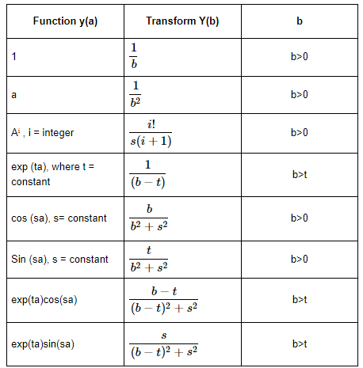

Slide 36
The Inverse Laplace Transform
Example 1
Find the inverse Laplace transform of
Solution:

Slide 37
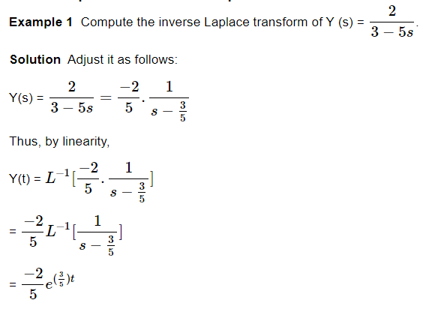

Slide 38
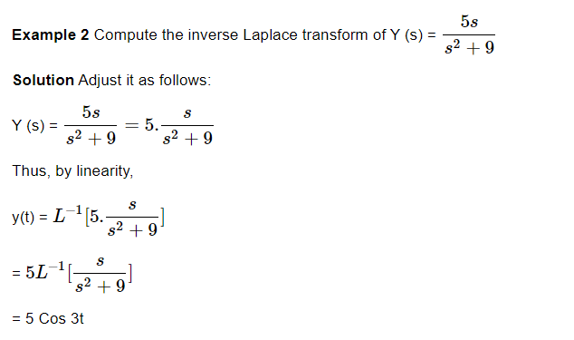

Slide 39
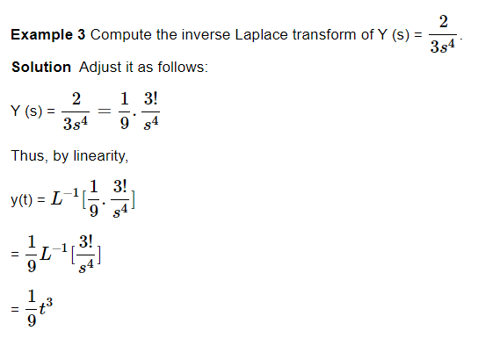

Slide 40
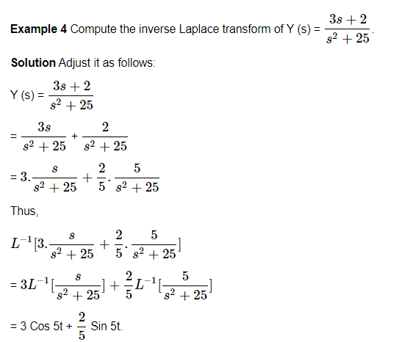

Slide 41
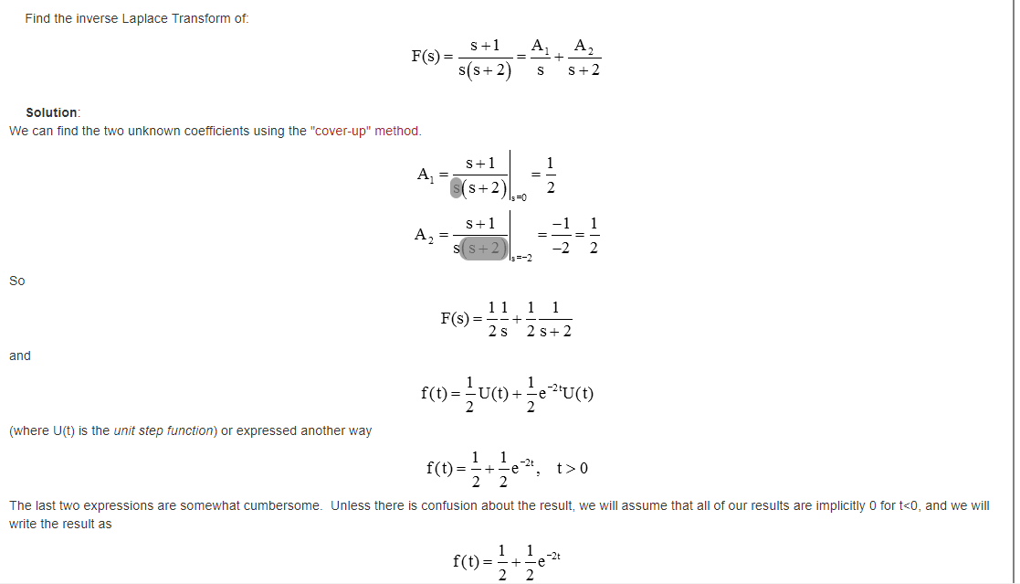

Slide 42
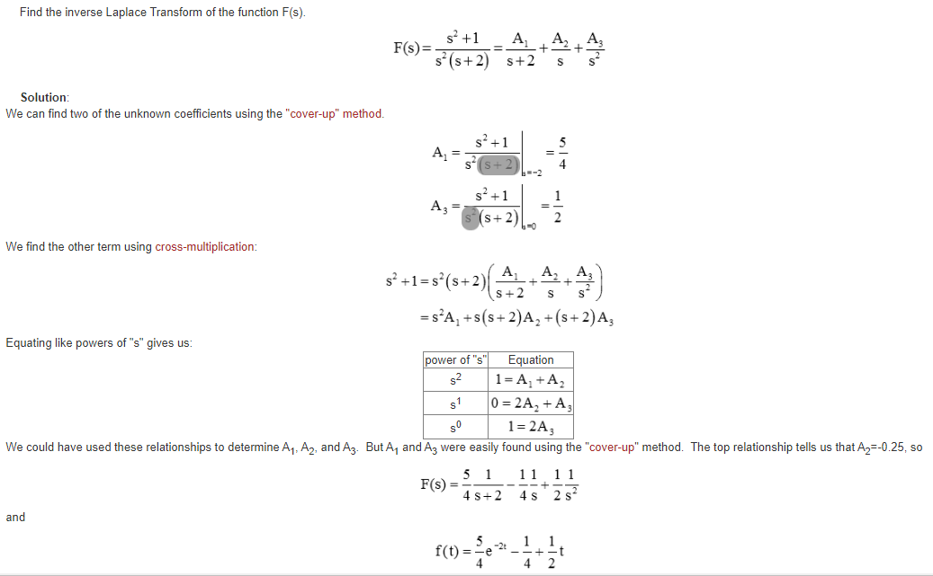

Slide 43
Partial Fraction Expansion
Distinct Real Roots of D(s)
s₁= 0, s₂= -8
s₃= -6

Slide 44
1) Distinct Real Roots
To find K₁: multiply both sides by s and evaluates both sides at s=0
To find K₂: multiply both sides by s+8 and evaluates both sides at s=-8
To find K₃: multiply both sides by s+6 and evaluates both sides at s=-6

Slide 45
Find K₁

Slide 46
Find K₂

Slide 47
Find K₃

Slide 48
Inverse Laplace of F(s)

Slide 49
The z-Transform
Introduction

Slide 50
Why z-Transform?
A generalization of Fourier transform
Why generalize it?
FT does not converge on all sequence
Notation good for analysis
Bring the power of complex variable theory deal with the discrete-time signals and systems

Slide 51
The z-Transform

Slide 52
Definition
The z-transform of sequence x(n) is defined by
Fourier Transform
Let z = e^{−jω}.

Slide 53
z-Plane
Im
z = e^{−jω}
ω
Re
Fourier Transform is to evaluate z-transform on a unit circle.

Slide 54
z-Plane
Im
X(z)
z = e^{−jω}
ω
Re
Im
Re

Slide 55
Periodic Property of FT
X(e^{jω})
X(z)
−π
π
ω
Im
Re
Can you say why Fourier Transform is a periodic function with period 2π?

Slide 56
The z-Transform
Zeros and Poles

Slide 57
Definition
Give a sequence, the set of values of z for which the z-transform converges, i.e., |X(z)|<∞, is called the region of convergence.
ROC is centered on origin and consists of a set of rings.

Slide 58
Example: Region of Convergence
Im
ROC is an annual ring centered on the origin.
r
Re

Slide 59
Inner ROC: This is the smallest region in the complex plane that encloses all poles of the Z-transform. It is the region where the Z-transform converges absolutely and uniformly.
Outer ROC: This is the region outside the outermost pole of the Z-transform. It is the region where the Z-transform diverges or does not exist.
Intermediate ROC: This is the region between the inner and outer ROCs, where the Z-transform converges conditionally.

Slide 60
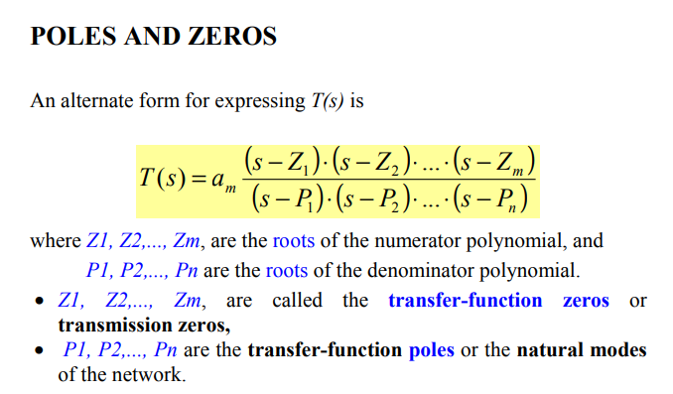
A pole of a Z-transform is a value of z for which the Z-transform is infinite or undefined.

Slide 61
A zero of a Z-transform is a value of z for which the Z-transform is zero.

Slide 62
Stable Systems
A stable system requires that its Fourier transform is uniformly convergent.
Im
Fact: Fourier transform is to evaluate z-transform on a unit circle.
A stable system requires the ROC of z-transform to include the unit circle.
1
Re

Slide 63
Example: A right sided Sequence
x(n)
. . .
n
-8
-7
-6
-5
-4
-3
-2
-1
1
2
3
4
5
6
7
8
9
10

Slide 64
Example: A right sided Sequence
For convergence of X(z), we require that

Slide 65
Example: A right sided Sequence ROC for x(n)=a^{n}u(n)
Which one is stable?
Im
Im
1
1
−a
a
−a
a
Re
Re

Slide 66
Example: A left sided Sequence
-8
-7
-6
-5
-4
-3
-2
-1
1
2
3
4
5
6
7
8
9
10
n
. . .
x(n)

Slide 67
Example: A left sided Sequence
For convergence of X(z), we require that

Slide 68
Example: A left sided Sequence ROC for x(n)=−a^{n}u(− n−1)
Which one is stable?
Im
Im
1
1
−a
a
−a
a
Re
Re

Slide 69
The z-Transform
Region of Convergence

Slide 70
Represent z-transform as a Rational Function
where P(z) and Q(z) are polynomials in z.
Zeros: The values of z’s such that X(z) = 0
Poles: The values of z’s such that X(z) = ∞

Slide 71
Example: A right sided Sequence
Im
ROC is bounded by the pole and is the exterior of a circle.
a
Re

Slide 72
Example: A left sided Sequence
Im
ROC is bounded by the pole and is the interior of a circle.
a
Re

Slide 73
Example: Sum of Two Right Sided Sequences
Im
ROC is bounded by poles and is the exterior of a circle.
1/12
−1/3
1/2
Re
ROC does not include any pole.

Slide 74
Example: A Two Sided Sequence
Im
ROC is bounded by poles and is a ring.
1/12
−1/3
1/2
Re
ROC does not include any pole.

Slide 75
Example: A Finite Sequence
Im
N-1 zeros
ROC: 0 < z < ∞
ROC does not include any pole.
N-1 poles
Re
Always Stable

Slide 76
Properties of ROC
A ring or disk in the z-plane centered at the origin.
The Fourier Transform of x(n) is converge absolutely iff the ROC includes the unit circle.
The ROC cannot include any poles
Finite Duration Sequences: The ROC is the entire z-plane except possibly z=0 or z=∞.
Right sided sequences: The ROC extends outward from the outermost finite pole in X(z) to z=∞.
Left sided sequences: The ROC extends inward from the innermost nonzero pole in X(z) to z=0.

Slide 77
More on Rational z-Transform
Consider the rational z-transform
with the pole pattern:
Im
Find the possible ROC’s
a
b
c
Re

Slide 78
More on Rational z-Transform
Consider the rational z-transform
with the pole pattern:
Im
Case 1: A right sided Sequence.
a
b
c
Re

Slide 79
More on Rational z-Transform
Consider the rational z-transform
with the pole pattern:
Im
Case 2: A left sided Sequence.
a
b
c
Re

Slide 80
More on Rational z-Transform
Consider the rational z-transform
with the pole pattern:
Im
Case 3: A two sided Sequence.
a
b
c
Re

Slide 81
More on Rational z-Transform
Consider the rational z-transform
with the pole pattern:
Im
Case 4: Another two sided Sequence.
a
b
c
Re

Slide 82
Bounded Signals

Slide 83
BIBO Stability
Bounded Input Bounded Output Stability
If the Input is bounded, we want the Output is bounded, too
If the Input is unbounded, it’s okay for the Output to be unbounded
For some computing systems, the output is intrinsically bounded (constrained), but limit cycle may happen

Slide 84
The z-Transform
Important
z-Transform Pairs

Slide 85
Z-Transform Pairs
Sequence
z-Transform
ROC
All z
All z except 0 (if m>0)
or ∞ (if m<0)

Slide 86
Z-Transform Pairs
Sequence
z-Transform
ROC

Slide 87
Signal Type ROC
Finite-Duration Signals
Causal
Entire z-plane
Except z = 0
Anticausal
Entire z-plane
Except z = infinity
Two-sided
Entire z-plane
Except z = 0
And z = infinity
Causal
Infinite-Duration Signals
|z| > r₂
Anticausal
|z| < r₁
Two-sided
r₂ < |z| < r₁

Slide 88
Some Common z-Transform Pairs
Sequence Transform ROC
1. δ[n] 1 all z
2. u[n] z/(z-1) |z|>1
3. -u[-n-1] z/(z-1) |z|<1
4. δ[n-m] z^{-m} all z except 0 if m>0 or ฅ if m<0
5. a^{n}u[n] z/(z-a) |z|>|a|
6. -a^{n}u[-n-1] z/(z-a) |z|<|a|
7. na^{n}u[n] az/(z-a)² |z|>|a|
8. -na^{n}u[-n-1] az/(z-a)² |z|<|a|
9. [cosω₀n]u[n] (z²-[cosω₀]z)/(z²-[2cosω₀]z+1) |z|>1
10. [sinω₀n]u[n] [sinω₀]z)/(z²-[2cosω₀]z+1) |z|>1
11. [r^{n}cosω₀n]u[n] (z²-[rcosω₀]z)/(z²-[2rcosω₀]z+r²) |z|>r
12. [r^{n}sinω₀n]u[n] [rsinω₀]z)/(z²-[2rcosω₀]z+r²) |z|>r
13. a^{n}u[n] - a^{n}u[n-N] (z^{N}-a^{N})/z^{N-1}(z-a) |z|>0

Slide 89
The z-Transform
Inverse z-Transform

Slide 90
Inverse Z-Transform by Partial Fraction Expansion
Assume that a given z-transform can be expressed as
Apply partial fractional expansion
First term exist only if M>N
B_{r} is obtained by long division
Second term represents all first order poles
Third term represents an order s pole
There will be a similar term for every high-order pole
Each term can be inverse transformed by inspection

Slide 91
Partial Fractional Expression
Coefficients are given as
Easier to understand with examples

Slide 92
Example: 2nd Order Z-Transform
Order of nominator is smaller than denominator (in terms of z⁻¹)
No higher order pole

Slide 93
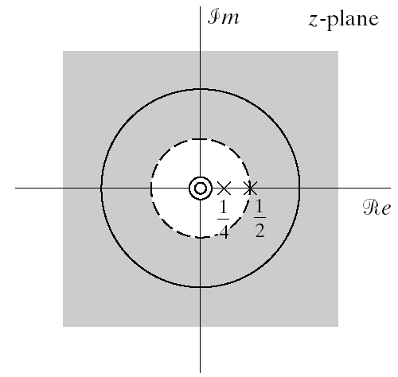
Example Continued
ROC extends to infinity
Indicates right sided sequence

Slide 94
Example #2
Long division to obtain B_{o}

Slide 95
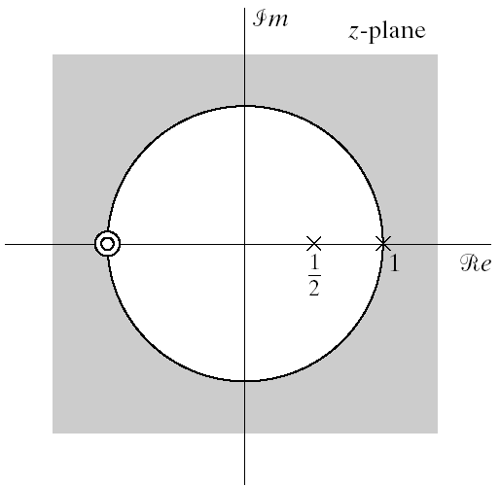
Example #2 Continued
ROC extends to infinity
Indicates right-sides sequence

Slide 96
An Example – Complete Solution

Slide 97
Inverse Z-Transform by Power Series Expansion
The z-transform is power series
In expanded form
Z-transforms of this form can generally be inversed easily
Especially useful for finite-length series
Example

Slide 98
Z-Transform Properties: Linearity
Notation
Linearity
Note that the ROC of combined sequence may be larger than either ROC
This would happen if some pole/zero cancellation occurs
Example:
Both sequences are right-sided
Both sequences have a pole z=a
Both have a ROC defined as |z|>|a|
In the combined sequence the pole at z=a cancels with a zero at z=a
The combined ROC is the entire z plane except z=0
We did make use of this property already, where?

Slide 99
Z-Transform Properties: Time Shifting
Here n_{o} is an integer
If positive the sequence is shifted right
If negative the sequence is shifted left
The ROC can change the new term may
Add or remove poles at z=0 or z=∞
Example

Slide 100
Z-Transform Properties: Multiplication by Exponential
ROC is scaled by |z_{o}|
All pole/zero locations are scaled
If z_{o} is a positive real number: z-plane shrinks or expands
If z_{o} is a complex number with unit magnitude it rotates
Example: We know the z-transform pair
Let’s find the z-transform of

Slide 101
Z-Transform Properties: Differentiation
Example: We want the inverse z-transform of
Let’s differentiate to obtain rational expression
Making use of z-transform properties and ROC

Slide 102
Z-Transform Properties: Conjugation
Example

Slide 103
Z-Transform Properties: Time Reversal
ROC is inverted
Example:
Time reversed version of

Slide 104
Z-Transform Properties: Convolution
Convolution in time domain is multiplication in z-domain
Example:Let’s calculate the convolution of
Multiplications of z-transforms is
ROC: if |a|<1 ROC is |z|>1 if |a|>1 ROC is |z|>|a|
Partial fractional expansion of Y(z)

Slide 105
The z-Transform
z-Transform Theorems and Properties

Slide 106
Linearity
Overlay of
the above two
ROC’s

Slide 107
Shift

Slide 108
Multiplication by an Exponential Sequence

Slide 109
Differentiation of X(z)

Slide 110
Conjugation

Slide 111
Reversal

Slide 112
Real and Imaginary Parts

Slide 113
Initial Value Theorem

Slide 114
Convolution of Sequences

Slide 115
Convolution of Sequences

